Slide 1
Critical Rendering Path

Slide 2
Constructing Document Object Model
<html> <head>
<meta name="viewport" content="width=device-width,initial-scale=1">
<link href="style.css" rel="stylesheet">
<title>Critical Path</title>
</head> <body>
<p>Hello <span>web performance</span> students!</p>
<div>
<img src="awesome-photo.jpg">
</div>
</body> </html>
Как браузер обрабатывает данный HTML?

Slide 3
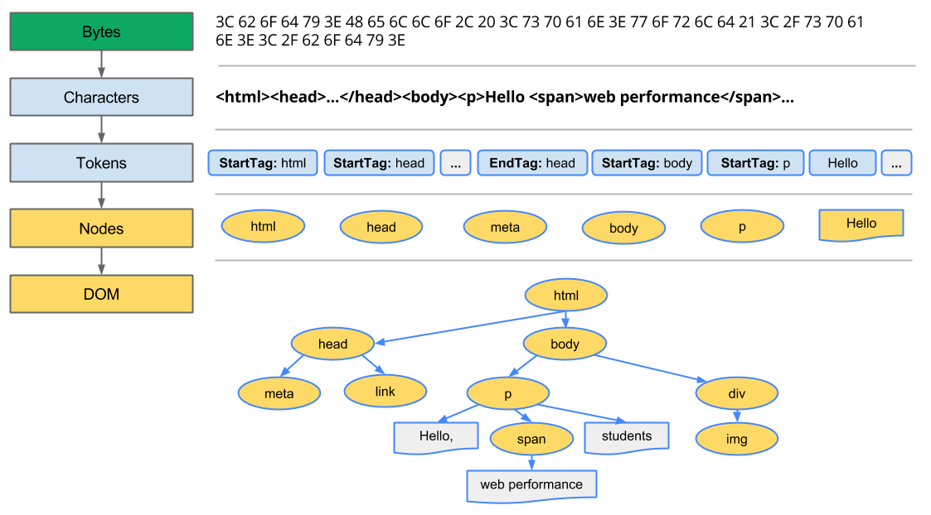
Constructing Document Object Model
Notes:
Conversion: The browser reads the raw bytes of HTML off the disk or network, and translates them to individual characters based on specified encoding of the file (for example, UTF-8).
Tokenizing: The browser converts strings of characters into distinct tokens—as specified by the W3C HTML5 standard; for example, "<html>", "<body>"—and other strings within angle brackets. Each token has a special meaning and its own set of rules.
Lexing: The emitted tokens are converted into "objects," which define their properties and rules.
DOM construction: Finally, because the HTML markup defines relationships between different tags (some tags are contained within other tags) the created objects are linked in a tree data structure that also captures the parent-child relationships defined in the original markup: the HTML object is a parent of the body object, the body is a parent of the paragraph object, and so on.

Slide 4
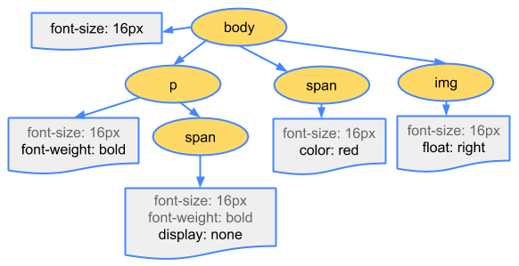
Constructing CSS Object Model
body { font-size: 16px }
p { font-weight: bold }
span { color: red }
p span { display: none }
img { float: right }

Slide 5
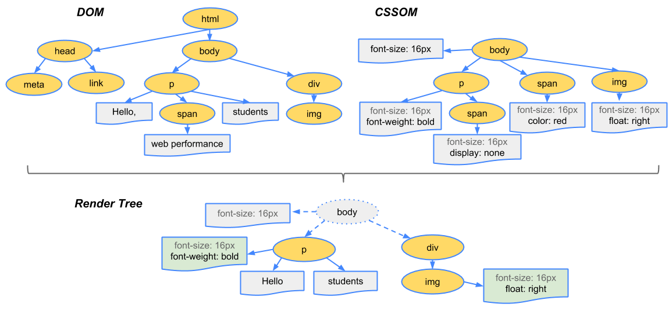
Constructing Render Tree
Notes:
Starting at the root of the DOM tree, traverse each visible node.
Some nodes are not visible (for example, script tags, meta tags, and so on), and are omitted since they are not reflected in the rendered output.
Some nodes are hidden via CSS and are also omitted from the render tree; for example, the span node---in the example above---is missing from the render tree because we have an explicit rule that sets the "display: none" property on it.
For each visible node, find the appropriate matching CSSOM rules and apply them.
Emit visible nodes with content and their computed styles.

Slide 6
Reflow (Layout) and Repaint (Rasterizing)
1.
Во время Reflow вычисляются координаты и размеры DOM элементов из Render Tree.
Все относительные величины транслируются в абсолютные.
Результатом является Box Model — свой прямоугольник каждого DOM элемента.
2.
Во время Repaint происходит отрисовка DOM элементов из Render Tree.
К этому моменту уже вычислены их размеры, положение, визуальное оформление.
Notes:
Process HTML markup and build the DOM tree.
Process CSS markup and build the CSSOM tree.
Combine the DOM and CSSOM into a render tree.
Run layout on the render tree to compute geometry of each node.
Paint the individual nodes to the screen.

Slide 7
JavaScript execution blocks on the CSSOM
<html>
<head>
<link href="style.css" rel="stylesheet">
<title>Critical Path</title>
</head>
<body>
<p>
Hello<span>web performance</span> students!
</p>
<div>
<img src="awesome-photo.jpg">
</div>
<script src="app.js"></script>
</body>
</html>
var span = document.getElementsByTagName('span')[0];
// change DOM text content
span.textContent = 'interactive’;
// change CSSOM property
span.style.display = 'inline';
// create a new element, style it, and append to DOM
var loadTime = document.createElement('div');
loadTime.textContent = 'Loaded on: ' + new Date();
loadTime.style.color = 'blue';
document.body.appendChild(loadTime);
Notes:
JavaScript can query and modify the DOM and the CSSOM.
JavaScript execution blocks on the CSSOM.
JavaScript blocks DOM construction (unless explicitly declared as async).
При наличии атрибута async браузер при возможности запускает скрипт асинхронно. Это означает, что указанный в атрибуте src файл будет выполняться без ожидания загрузки и отображения веб-страницы. В то же время и страница не ожидает результата выполнения скрипта, а продолжает загружаться как обычно.

Slide 8
What triggers a reflow or a repaint?
let bstyle = document.body.style;
bstyle.padding = "20px"; // reflow, repaint
bstyle.border = "10px solid red"; // another reflow and a repaint
bstyle.color = "blue"; // repaint only, no dimensions changed
bstyle.backgroundColor = "#fad"; // repaint
bstyle.fontSize = "2em"; // reflow, repaint
// new DOM element - reflow, repaint
document.body.appendChild(document.createTextNode('dude!'));
Notes:
Browsers can add to the queued changes and then flush the queue once a certain amount of time passes or a certain number of changes is reached.

Slide 9
What else trigger reflow?
let dStyle = document.getElementById('abc').style;
let offset = dStyle.offsetLeft;
let scroll = dStyle.scrollTop;
let width = dStyle.offsetWidth;
let computed = dStyle.getComputedStyle();
Notes:
But sometimes the script may prevent the browser from optimizing the reflows, and cause it to flush the queue and perform all batched changes. This happens when you request style information.

Slide 10
Web Performance

Slide 11
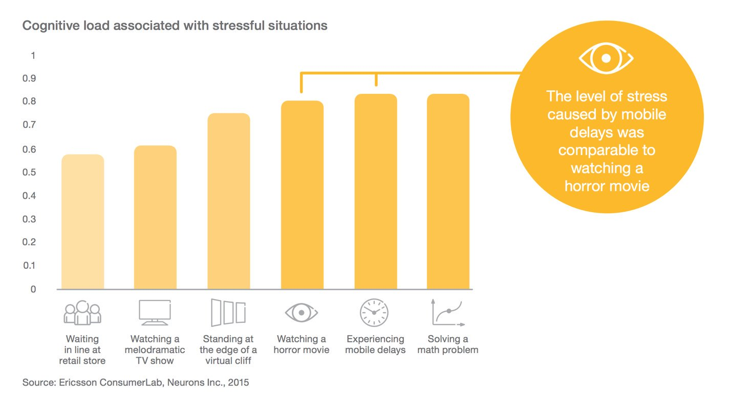
Slow site is very uncomfortable

Slide 12
Performance affects business
— In 2016, AliExpress made their site faster by a third and received 10.5% more orders
— Back in 2006, Google tried making the search slower by half-a-second and discovered that users were making 25% fewer requests
— In 2008, Aberdeen Group discovered that slowing a site down by one second decreases the user satisfaction by 16%

Slide 13
What is performance?
Server responds quickly
Web app loads and renders quickly
Web app works quickly

Slide 14
JavaScript code minification
Original:
function logArrayItems(element, index) {
console.log('a[' + index + '] = ' + element);
}
[1, 2, 3, 5, 8].forEach(logArrayItems);
Minified:
function logArrayItems(o,r){console.log("a["+r+"] = "+o)}
[1,2,3,5,8].forEach(logArrayItems);
Notes:
What is minification? When people write JS, they (usually) format it in a convenient way. They add indentation, use long meaningful names for variables, write comments, and so on. Thanks to this, the code is easier to read, but all the extra spacing and comments make it significantly larger.
To fight this, people came up with minification. During minification, the code loses all unnecessary characters, receives shorter variable names, and so on. In the end, it becomes smaller but keeps working as intended.
Minification makes the code take around 30–40% less size.
Minification is supported by every major app builder: — mode: production in webpack, — babel-preset-minify in Babel, — gulp-uglify in Gulp

Slide 15
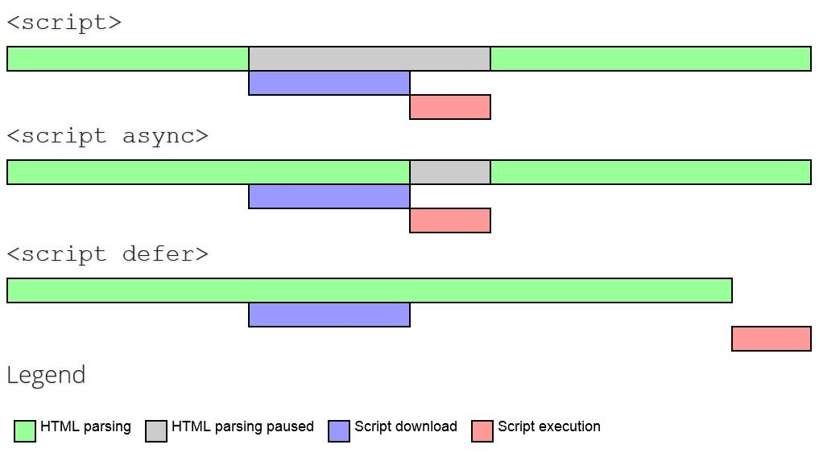
Asynchronous loading JavaScript
Notes:
— async asks the browser to load scripts asynchronously (in the background) and to continue parsing the document while scripts are downloading. (If a script loads before the parsing ends, parsing will pause; but because loading usually takes more time than parsing, this rarely happens.)
— defer tells the browser to download the script asynchronously and execute it only after the document is parsed.
— async scripts would execute as soon as they download, without keeping the order. This means that if you have an async React bundle and an async app bundle, and the React bundle is larger, the app would download and execute earlier than React – and the site will break.
— defer scripts, unlike async, would execute in the right order only after all scripts are downloaded. Because of this, defer might be safer than async when optimizing a large complex app.

Slide 16
Code splitting
framework-1.1.0.js
256 Kb
bundle.js
512 Kb
my-web-app.js
128 Kb
my-web-app--user-space.js
64 Kb
my-web-app--admin-space.js
64 Kb

Slide 17
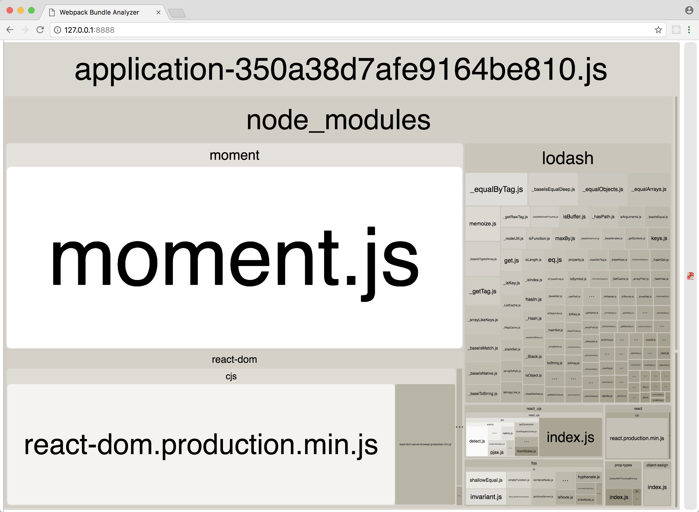
Unused code in dependencies

Slide 18
CSS Minification & Optimization
Original:
Optimized:
.foo {
width: 200px;
height: 100px;
}
.bar {
border-width: 1px;
border-style: solid;
border-color: red;
}
.foo{width:200px;height:100px}.bar{border:1px solid red}

Slide 19
Embedding critical styles
index.html
(HTML only)
10 Kb
index.html
(HTML & embedded critical CSS)
20 Kb
styles.css
(all CSS)
50 Kb
other-styles.css
(not critical CSS)
40 Kb
<style>
/* critical styles */
</style>
<link rel="preload" href="other-styles.css" as="style" onload="this.rel = 'stylesheet'" />
Notes:
That’s why the page remains white while styles are still loading.
Now, there’s a clever optimization trick here. It’s perfectly reasonable that browsers keep the page empty while styles haven’t loaded, and we don’t want to get rid of this. However, we can still make pages render faster – by loading the page with just a part of styles needed for initial rendering and fetching the remaining styles afterward. Those styles needed for initial rendering are called “Critical CSS”.

Slide 20
HTML Minification
<!DOCTYPE html>
<html>
<head>
<title>Page Title</title>
</head>
<body>
<h1>This is a Heading</h1>
<!-- comment -->
<p>This is a paragraph.</p>
</body>
</html>
<!DOCTYPE html><html><head><title>Page Title</title></head><body><h1>This is a Heading</h1><p>This is a paragraph.</p></body></html>

Slide 21
HTTP data compression
Request header:
accept-encoding: gzip, deflate, br
Web Browser
Web Server
Response header:
content-encoding: gzip
Response body:
Compressed with Gzip data
Notes:
The second approach to transfer less data is to compress everything you send to the client using Gzip.
Gzip is an algorithm that compresses data you send to the client using a sophisticated archiving algorithm. After compression, your documents will look like an unreadable binary soup, but their volume will be reduced by 60–80%. And when a browser receives the data, it will decompress it back.

Slide 22

Content Delivery Network

Slide 23
Preloading resources
<!-- DNS resolve -->
<link rel="dns-prefetch" href="//example.com">
<!-- TCP (TLS) connection establish -->
<link rel="preconnect" href="http://css-tricks.com">
<!-- Preload with low priority -->
<link rel="prefetch" href="image.png">
<!-- Preload with high priority -->
<link rel="preload" href="image.png">
<!-- Prerender page -->
<link rel="prerender" href="http://css-tricks.com">
Notes:
Did you know Google starts preloading the first link in search results as soon as you do a search? That’s because a third of all visitors click the first link, and preloading it allows them to see the target site faster.
If you have pages or resources that you know will also be needed in a short time, browsers let you preload them in advance – just like Google does.
— <link rel="dns-prefetch"> instructs the browser to make a DNS request for a server’s IP address in advance. This is useful for CDNs, Google Fonts, and all other cases when you know you’ll need a resource in a short time, know the domain it’s hosted at, but don’t know its exact path. In this case, resolving the server’s IP address in advance would save you from 50 to 300 ms.
— <link rel="preconnect"> instructs the browser to perform the connection to a server in advance. It’s useful in the same cases when dns-prefetch is useful, but sets up a full connection and saves more time. The drawback here is that opening a new connection is pretty resource-intensive, so you don’t want to overuse this optimization.
— <link rel="prefetch"> preloads and caches a resource in background with a low priority. This is useful e.g. to preload a JS bundle for the next page of an app.
— <link rel="preload"> preloads a resource in background with a high priority. This is useful to preload a resource you’ll need in several seconds – e.g.,a non-critical CSS file.
— <link rel="prerender"> preloads the specified page in the background and renders it in an invisible tab. Later, when a visitor clicks to a link leading to the prerendered page, the page displays immediately. This is what Google uses to preload its first search result.

Slide 24
Suitable image format
svg is best for vector images such as icons or logos
jpg is best for photos because it compresses images with a slight quality loss not visible by the human eye
png is best for raster graphics that you want to display without any quality losses – e.g., raster icons or pixel art
mp4 is best for animation (don’t use gif at all)

Slide 25

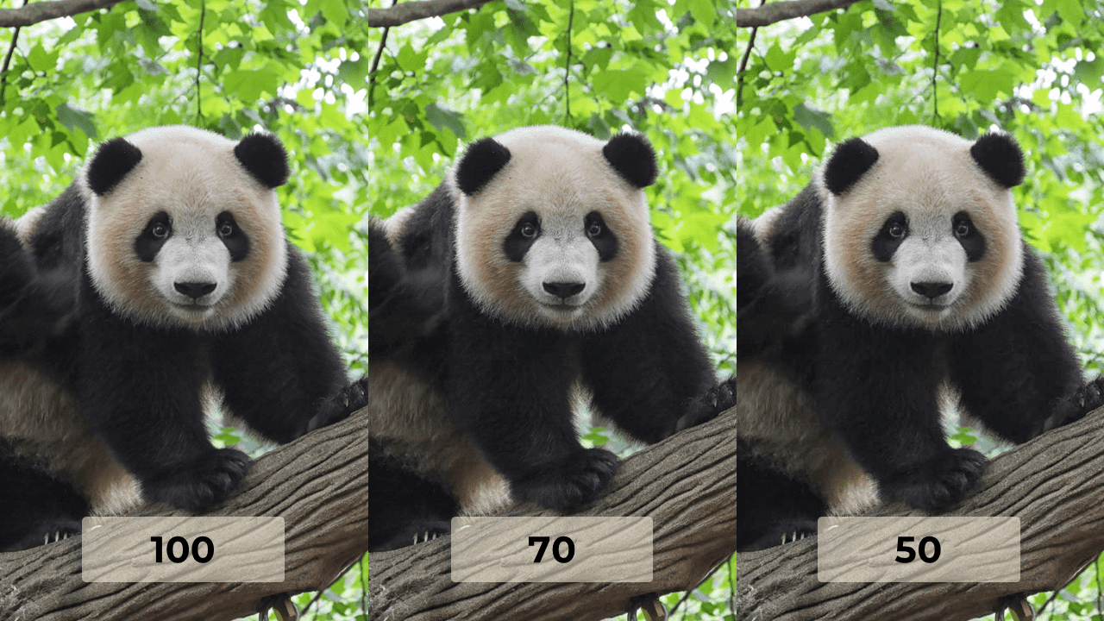
JPG compression level
669 Kb
100 Kb
74 Kb

Slide 26

SVG Minification & Optimization
<!-- Generated by IcoMoon.io -->
<svg version="1.1" xmlns="http://www.w3.org/2000/svg" width="512" height="512" viewBox="0 0 512 512">
<title></title>
<g id="icomoon-ignore">
</g>
<path
d="M240 352c44.183 0 80-35.817 80-80v-192c0-44.183-35.817-80-80-80s-80 35.817-80 80v192c0 44.183 35.818 80 80 80zM352 224v48c0 61.855-50.145 112-112 112s-112-50.145-112-112v-48h-32v48c0 74.119 56.002 135.15 128 143.11v64.89h-64v32h160v-32h-64v-64.89c71.997-7.96 128-68.991 128-143.11v-48h-32z">
</path>
</svg>
<svg xmlns="http://www.w3.org/2000/svg" width="512" height="512" viewBox="0 0 512 512"><path d="M240 352c44.2 0 80-35.8 80-80v-192c0-44.2-35.8-80-80-80s-80 35.8-80 80v192c0 44.2 35.8 80 80 80zM352 224v48c0 61.9-50.1 112-112 112s-112-50.1-112-112v-48h-32v48c0 74.1 56 135.2 128 143.1v64.9h-64v32h160v-32h-64v-64.9c72-8 128-69 128-143.1v-48h-32z"/></svg>

